Slide 1
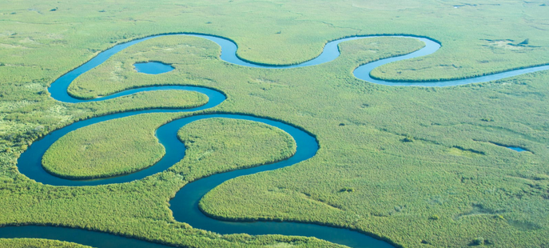
Controls on Geometry of
Meandering Streams
Mustafa Al Ibrahim and Tanvi Chheda
Notes:
Meandering of rivers is an important topic in geology and civil engg because channel migration has practical implications in land use, sediment budgets, and navigation.

Slide 2
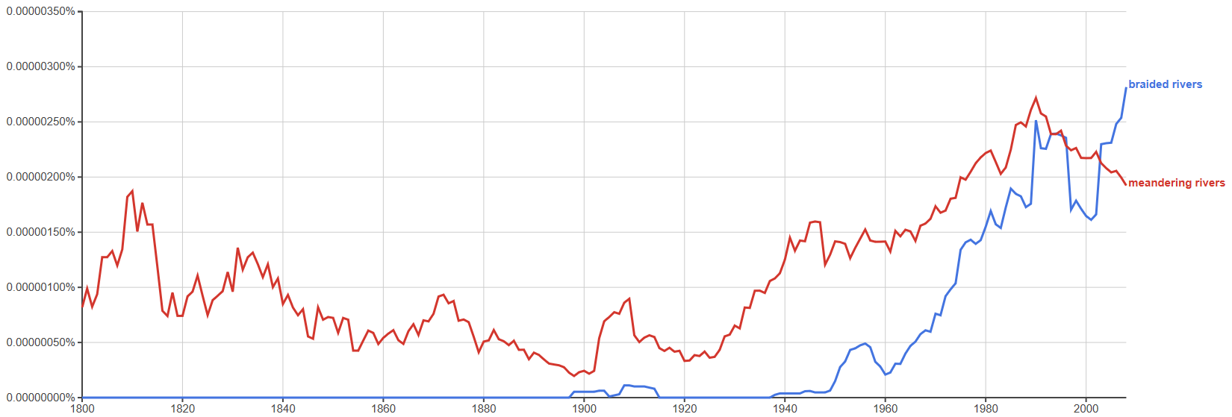
Historical context
1800
Year
2018
(Google, 2018)
Notes:
Research on braided rivers in recent, but on meandering rives has been ongoing since a long time

Slide 3
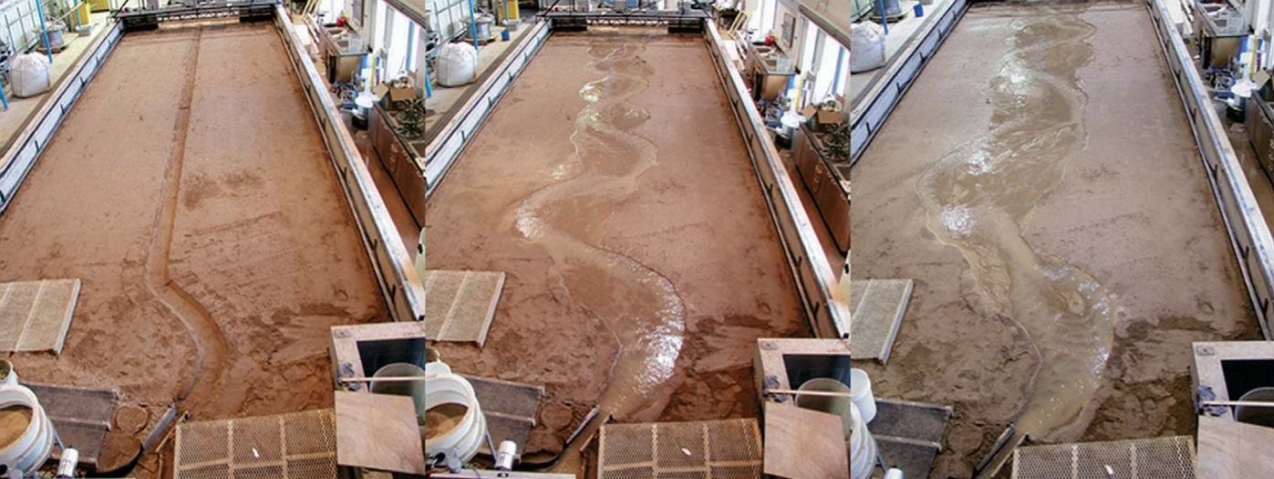
Different channel patterns
(Parker et al., 2011)
Time: 0 h
Straight channel pattern
Time: 22 h
Meandering channel pattern
Time: 43 h
Braided channel pattern

Slide 4
How to study river geomorphology and evolution
Go to the river and measure geomorphology with time
Study outcrops of river deposits
Flume experiments
Study time-lapse satellite images
Numerically simulate river evolution
Analytical: 1D curves or sediment balance calculations
Numerical: Flow modeling with fluid-solid interactions

Slide 5
How to model a meandering rives
What are factors effecting river migration
Flow dynamics aspects (e.g., flow velocity; regime)
Slump blocks armoring
Vegetation armoring
Sediment load, distribution of particle size
Animal activity
Cohesion, etc.
Need coupling of large number of physical phenomena:
We don’t have equations describing all the processes
Numerical issues related to coupling and solving at different scales
Efficiency issue when running multiple models

Slide 6
How to model a meandering river?
Simplify:
Model rivers geometrically as curves.
Incorporate observations as rules that rely on “physical” parameters.

Slide 7
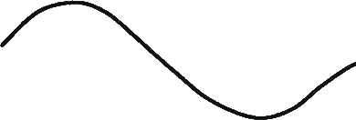
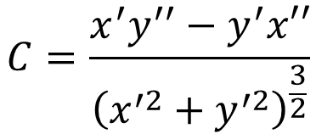
Observation 1: Migration rate follows the local curvature
Positive curvature
Higher curvature corresponds to higher migration rates.
This assumes that the geomorphology of the river is determined primarily by flow dynamics rather than debris load and other factors.
$$C=\frac{x^{′}y^{′′}−y^{′}x′′}{{\left(x^{′2}+y^{′2}\right)}^{\frac{3}{2}}}$$
zero
curvature
y
x
Negative curvature
(Leopold and Wolman, 1960)

Slide 8
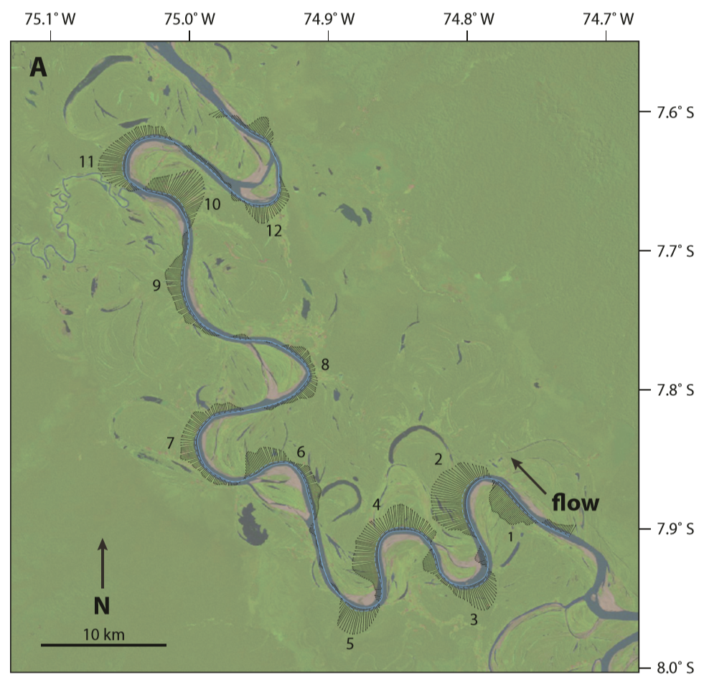
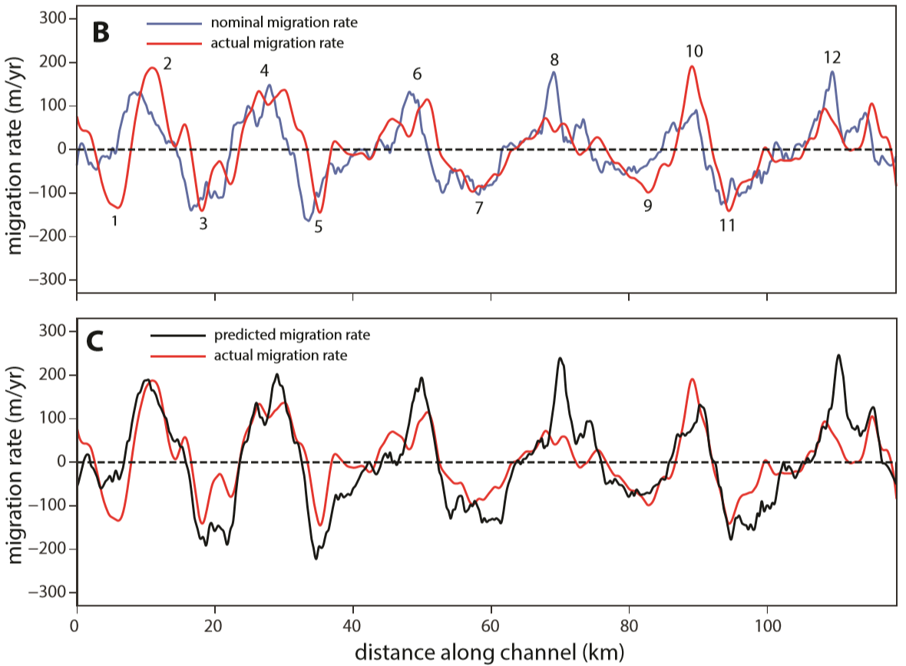
Observation 2: Meandering rivers migrate fastest and slightly downstream of locations of high curvature
Notes:
Analysis of channel migration of the Ucayali River, Peru, over a two year period. (A) Landsat image from 1987, with local migration rate vectors plotted. Bend numbers correspond to those shown in (B). (B) Along-channel variation of nominal migration rate and actual migration rate. (C) Plot of predicted and actual migration rates. Prediction is based on an erodibility constant of 300 m/yr and a friction factor of 0.007.

Slide 9
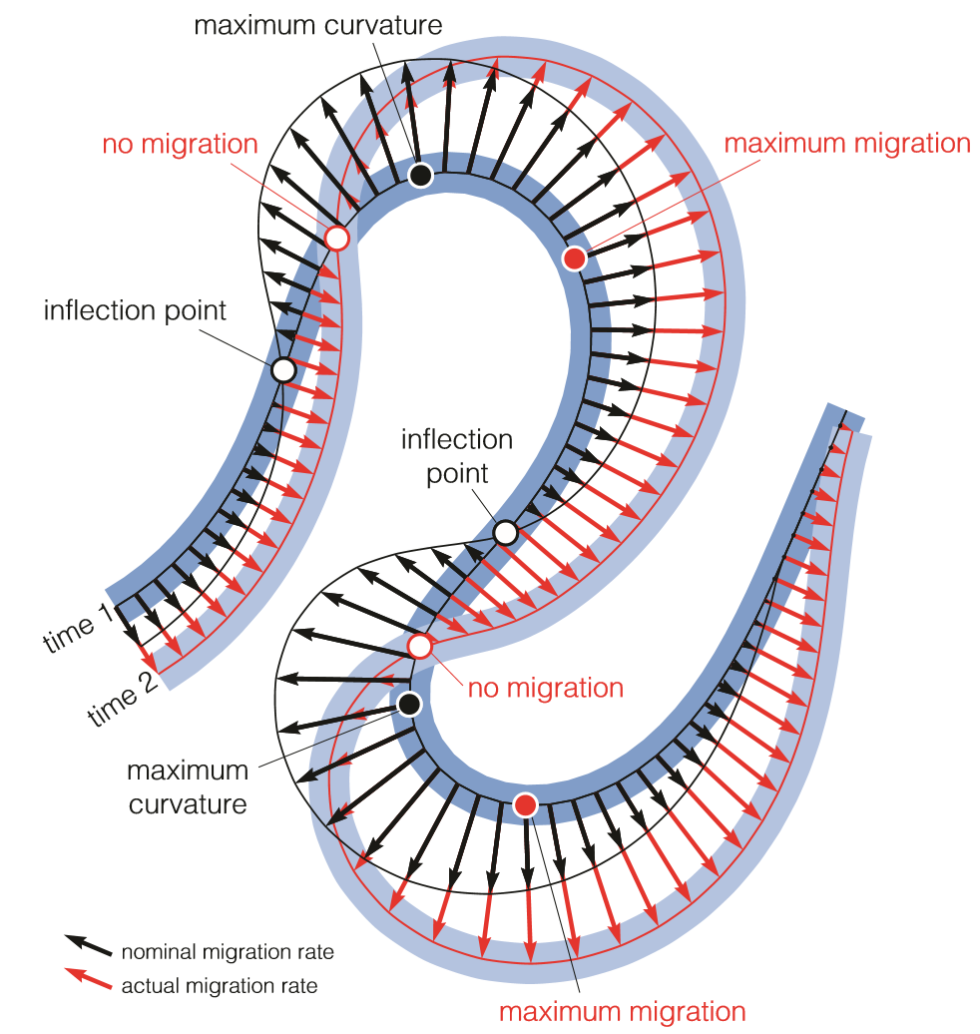
Nominal vs actual Migration rates
Nominal migration
Only takes into account the local curvature
Actual migration
takes into account local curvature and upstream curvature

Slide 10
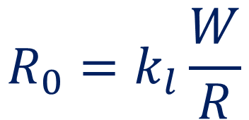
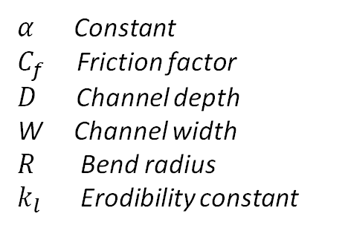
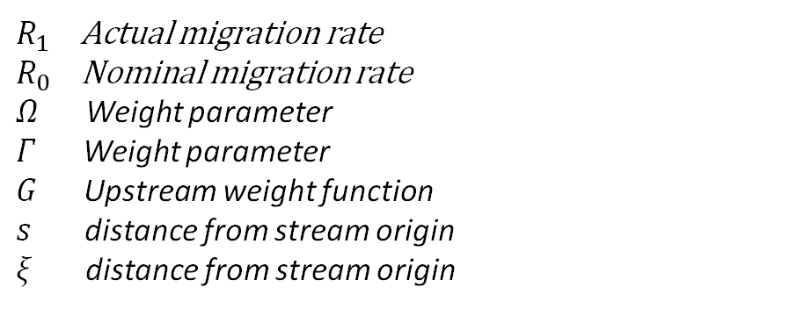
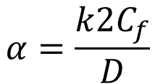
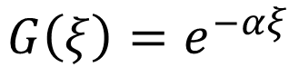
Model formulation
(Howard and Knutson, 1984)
Nominal
migration rate
Migration rate shift
$R_{1}\left(s\right)=ΩR_{0}\left(s\right)+\left(Γ\int_{0}^{∞}{R_{0}\left(s−ξ\right)G\left(ξ\right) dξ}\right){\left(\int_{0}^{∞}{G\left(ξ\right)dξ}\right)}^{−1}$
$$R_{0}=k_{l}\frac{W}{R}$$
Upstream weight function
$α$ Constant
$C_{f}$ Friction factor
$D$ Channel depth
W Channel width
$R$ Bend radius
$k_{l}$ Erodibility constant
$R_{1}$ Actual migration rate
$R_{0}$ Nominal migration rate
$Ω$ Weight parameter
$Γ$ Weight parameter
$G$ Upstream weight function
$s$ distance from stream origin
$ξ$ distance from stream origin
$$G\left(ξ\right)=e^{−αξ}$$
$$α=\frac{k2C_{f}}{D}$$

Slide 11
Practicalities
Define parameters
Initialize centerline with small noise (uniform) and padding at edges
Compute curvature and smooth it
Compute nominal migration rate
Compute adjusted migration rate
Migrate centerline, do not migrate edge padding
Resample using cubic b-spline
Save centerline
Smoothing of curvature (Gavitzky & Golay, 1964) was not applied!
Spline interpolation and resampling is very important for the stability of the method
(Sylvester et al., 2018)
Notes:
As far as we can tell, there doesn’t seem to be any smoothing done to the curvature

Slide 12
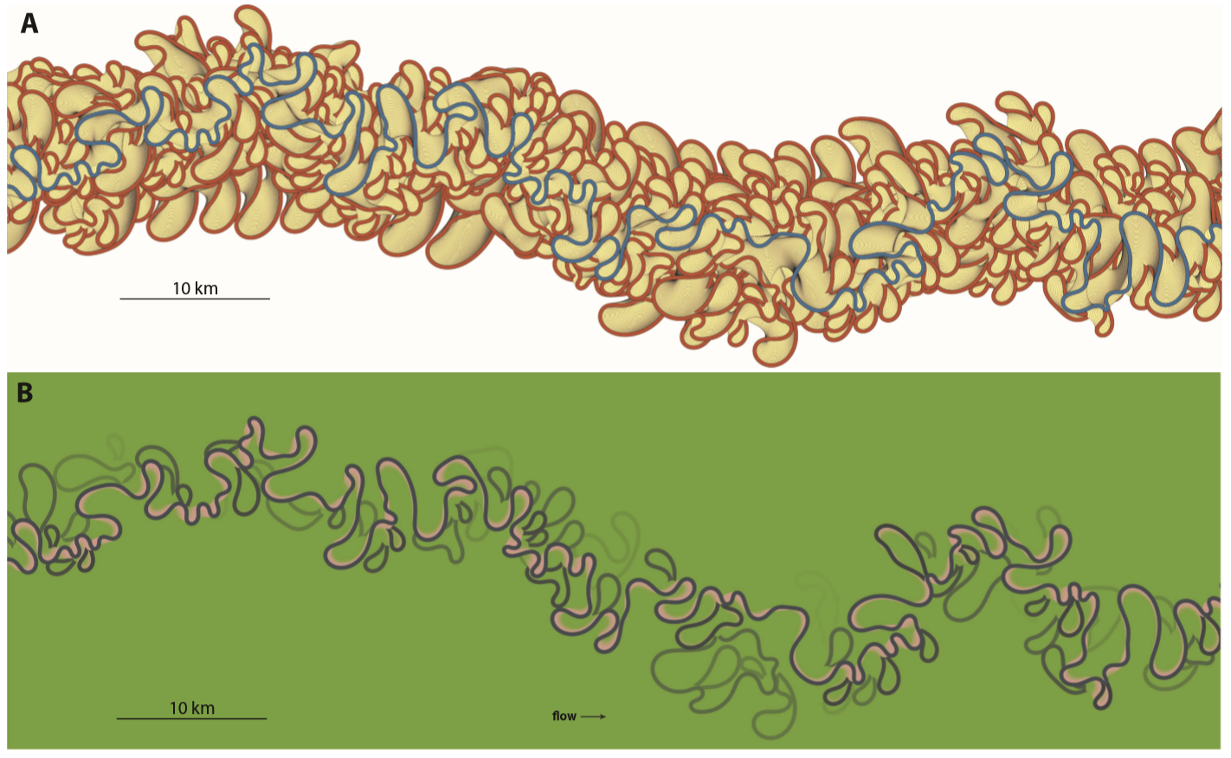
Long term simulation results

Slide 13
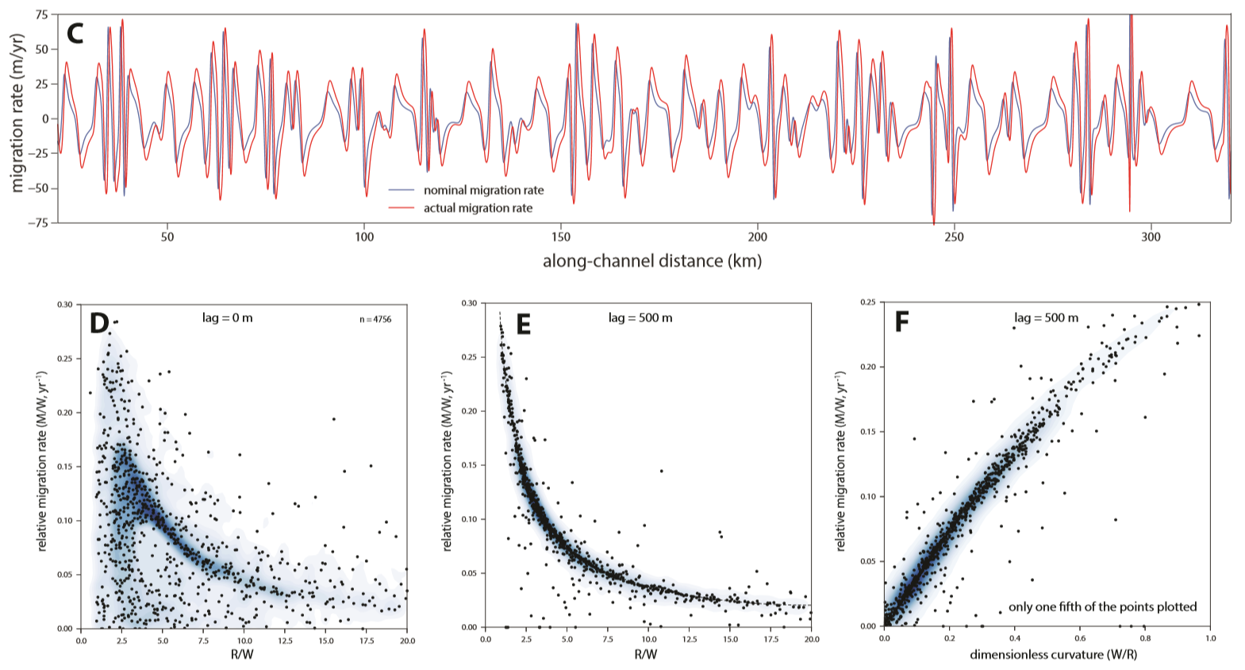
Long term simulation results

Slide 14
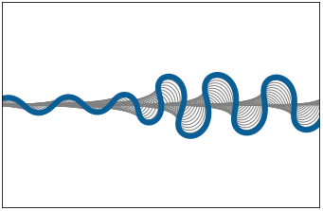
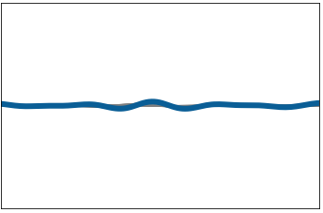
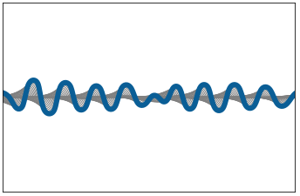
Case study (parameters and animation)
Wavelength a function of depth and width of stream
Decreasing effect of upstream curvature delays growth of meanders.
K = 1, Depth = 5
K = 0.9, Depth = 5
K = 1, Depth = 3

Slide 15
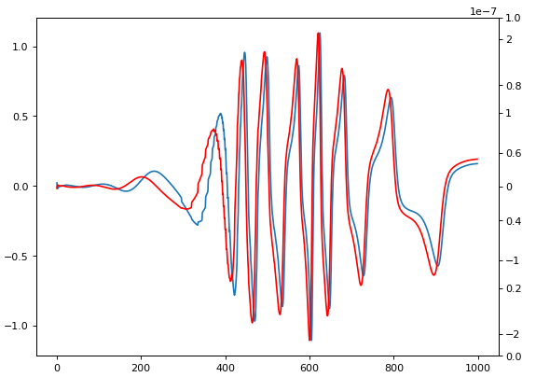
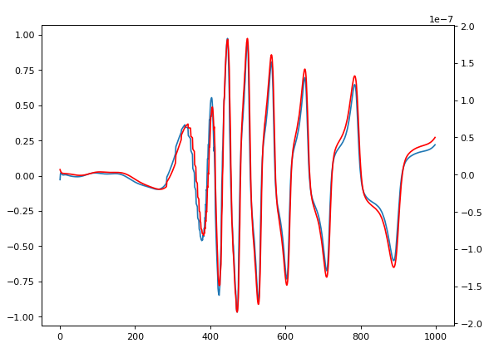
Lag and migration rate analysis
Actual migration at the same point
Actual migration rate measured
5 m downstream
Migration Rate
Curvature
Migration Rate
Curvature
Curvature
Migration Rate
Time Step
Time Step

Slide 16
Assumptions
Local channel gradient, parallel to flow assumed to be constant
Bank erosion is assumed proportional to shear stress, which is proportional to velocity/ slope. But as meanders increase, local slope will decrease and so will migration rate
Channel width is constant, independent of gradient

Slide 17
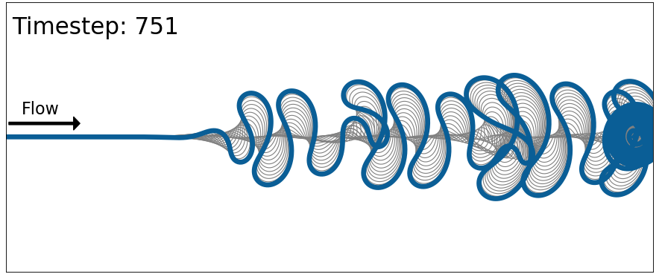
Issues
Centerline can intersect itself.
Artifacts related to anchoring the downstream end

Slide 18
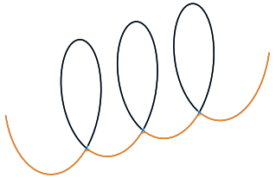
Extensions
Define parameters
Initialize centerline with small noise (uniform) and padding at edges
Compute curvature
Compute nominal migration rate
Compute adjusted migration rate
Migrate centerline, do not migrate edge padding
Resample using cubic b-spline
Save centerline and other information
Identify self intersection and create oxbow lakes
Modify downstream padding with repeated boundary condition
More realistic results by accounting for flow bypass and the formation of oxbow lakes.
Allow for downstream end to move.

Slide 19
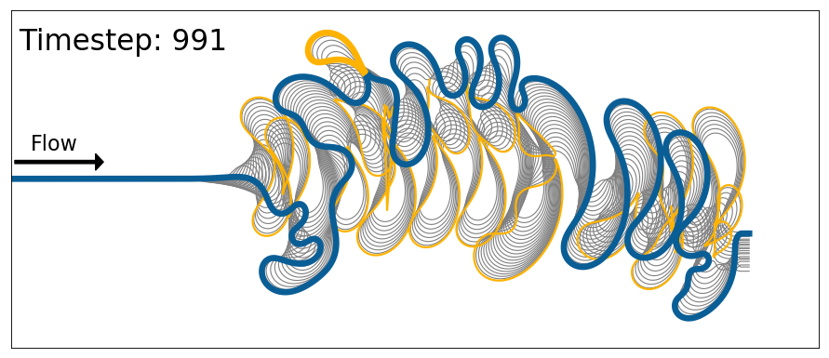
Extension results

Slide 20
Applications and predictive capabilities
Why geometrical approach is good
It is fast so we can run large number of models for uncertainty quantification.
Possible applications
Academic: studying oxbow lake formation and quantifying controlling parameters
Practical: quantification of uncertainty in sand/shale ratio or reservoir connectivity while taking into account oxbow lakes.

Slide 21
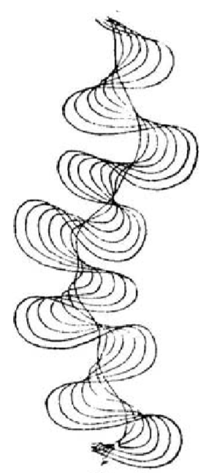
Conclusions and final remarks
Migration rate follows the local curvature with a constant phase lag.
Geometrical numerical simulation of river evolution can reproduce this observed behavior
In a lot of ways, scientist are just revisiting some old ideas and quantifying them using simulations
(Davis, 1903)

Slide 22
References
Davis, W. M., 1903, The development of river meanders: Geological Magazine, v. 10, no. 5, p. 145-148.
Howard, A. D., and Knutson, T. R., 1984, Sufficient conditions for river meandering: A simulation approach, Water resources research, v. 20, no. 22, p. 1659-1667.
Parker, G., Shimizu, Y., Wilkerson, G. V., Eke, E. C., Abad, J. D., Lauer, J. W., Paola, C., Dietrich, W. E., and Voller, V. R., 2011, A new framework for modeling the migration of meandering rivers: Earth surface processes and landforms, v. 36, p. 70-86.
Savitzky, A., and Golay, M. J. E., 1964, Smoothing and differentiation of data by simplified least squares procedures: Analytical chemistry, v. 36, no. 8, p. 1627-1639.
Sylvester, Z., Covault, J., and Durkin, P., 2018, High curvatures drive river meandering, in press.

